Slide 1




Credit Risk Analysis Insights for Informed Lending Decisions
Muhammad Gilang Mahardika
| mgilangmahardika11@gmail.com
| muhgilangmahardika
| UrsaG7

Slide 2

Table of
CONTENTS
01
02
03
BUSINESS UNDERSTANDING
EXPLORATORY DATA ANALYSIS & INSIGHT
DATA
PRE-PROCESSING
04
05
06
07
MODELLING & HYPERTUNING
FEATURE
IMPORTANCE
MODEL
RESULTS
BUSINESS
RECOMMENDATION

Slide 3
BUSINESS UNDERSTANDING| BACKGROUND
Problem
Out of 466,285 borrowers, around 11% of them have poor credit worthiness, which resulted in bad loans.
Analyze historical data to gain insights into borrowers credit activity and behavior.
Things to do
Goals
Decrease the percentage of borrowers with poor creditworthiness or credit scores from passing through loan approval.
Develop a predictive model that identifies risky borrowers based on their credit scores and behavior.
Objective
Business Metric
Loan Default Rate: The percentage of loans that ended up defaulting.

Slide 4








EDA & INSIGHT | DESCRIPTIVE ANALYSIS
Summary of General Dataset Overview
Data Length
466,285
Features
75
There are 17 features with the entirety of its data missing and 5 features missing more than half of its data.
The feature application_type only have a single unique value which is ‘INDIVIDUAL’.
There are 4 features with date values formatted as 'Jan-16'
Target
Loan Status
More than Half of the dataset’s features show a rightward skew, indicating data clusters around lower values with some concentrated high-value outliers.
Duplicated Data
0
The rest of the dataset’s features have a multimodal distribution, indicating multiple distinct clusters or variability within the data.
Missing Value
9,776,227

Slide 5
EDA & INSIGHT | DESCRIPTIVE ANALYSIS
11.62% of the total loans resulted in bad loans which lead to defaults.
Numerical features make up a significant portion of the total dataset.
88.38%
46
21
11.62%
Good Loan
Bad Loan
Categorical
Numerical
The dataset is heavily imbalanced towards the positive class, with a ratio of a little less than 1:8
Most numerical features are decimals, with only a 8 of them as whole numbers.

Slide 6
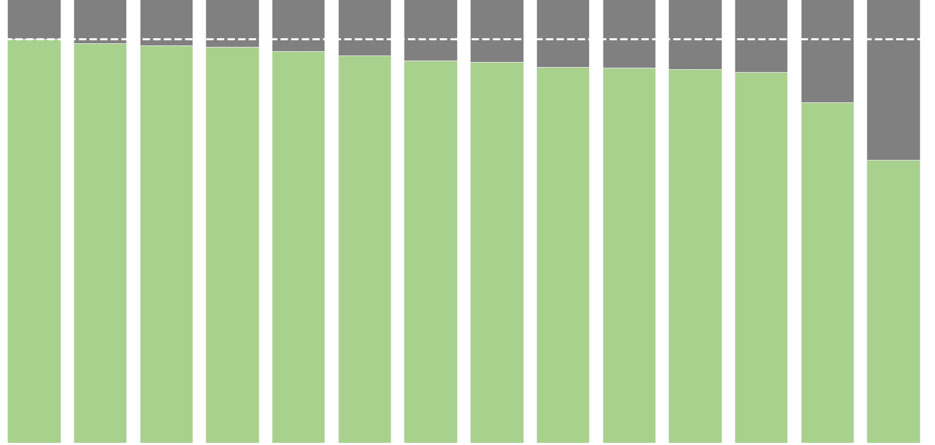
EDA & INSIGHT | UNIVARIATE ANALYSIS
90.91%
88.09%
Good Loans rate by Purpose
63.74%
Credit Card
90.91%
Educational
63.74%
Average
84.59%
Credit Card
Car
Home Improvement
Major Purchase
Debt Consolidation
Vacation
Wedding
Medical
Other
House
Renewable Energy
Moving
Small Business
Educational
Highest Borrower Percentage
58%
Credit card loans have the highest good loan rate of 90.91%, despite accounting for only one-fourth of the total borrowers. This trend of high-risk loans also applies to debt consolidation, which is the most popular category with a high good loan rate of 88.09% and accounts for 58% of the total borrower. On the other hand, loans for educational purposes show the opposite trend, with the lowest percentage of good loans.

Slide 7
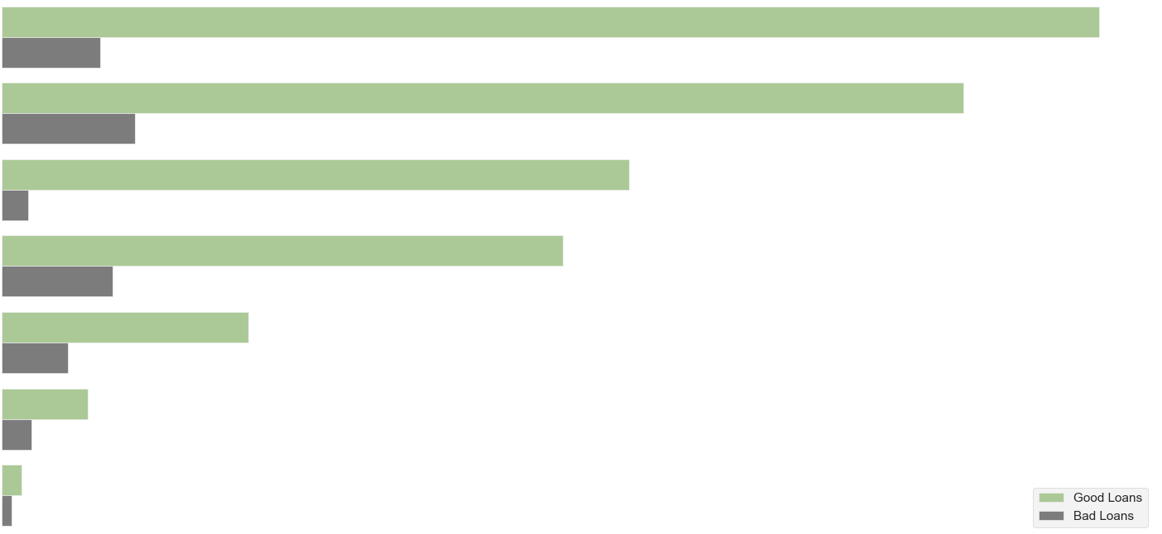
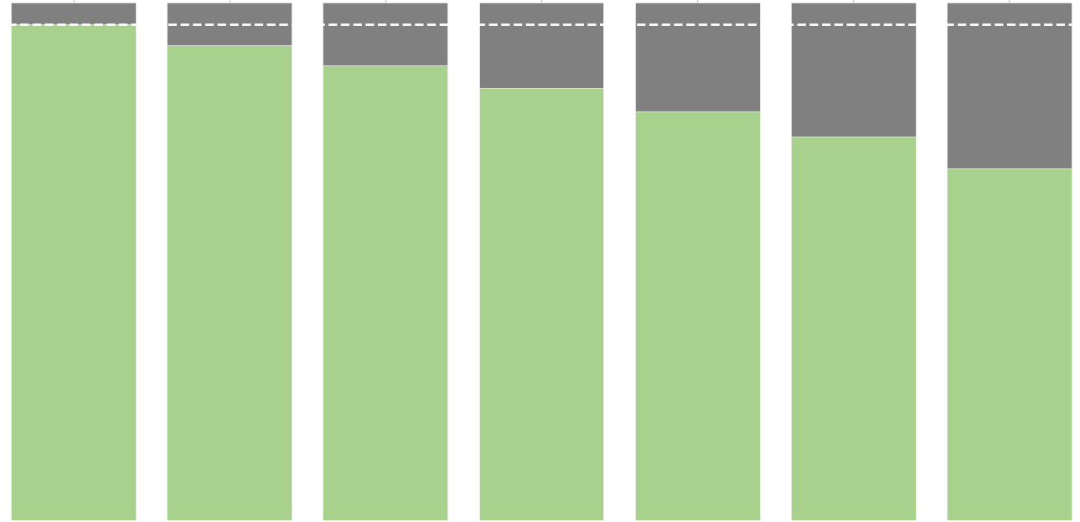
EDA & INSIGHT | UNIVARIATE ANALYSIS
B
26.95%
Loan Status by Grades
2.42%
C
23.61%
15.40%
Grade A loans have the fewest bad loans relative to it size, despite making up more than half of the highest category.
Grade B borrowers represent the largest portion of good loans at 26.95%, followed closely by Grade C at 23.61%. These grades indicate a strong foundation of low-risk borrowers with good credit profiles. On the other end of the spectrum, Grades E, F, and G represent a smaller percentage of good loans but carry the highest default risk, requiring more stringent lending criteria.
A
D
13.78%
E
6.06%
F
2.10%
G
0.48%
4.07%
Loan Grades Trend
95.93%
32.03%
There is a clear upward trend in risk, as evidenced by the percentage increase in bad loans, from 4% and doubling as the grades decrease. This indicates an exponential increase in risk as the loan grades drop from A to G.
However, it is expected that more than 82% of clients within their loan-grade group will have good loans. This suggests that the company can anticipate the majority of clients in each loan grade to be able to repay their loans.
67.97%
A
B
C
D
E
F
G

Slide 8
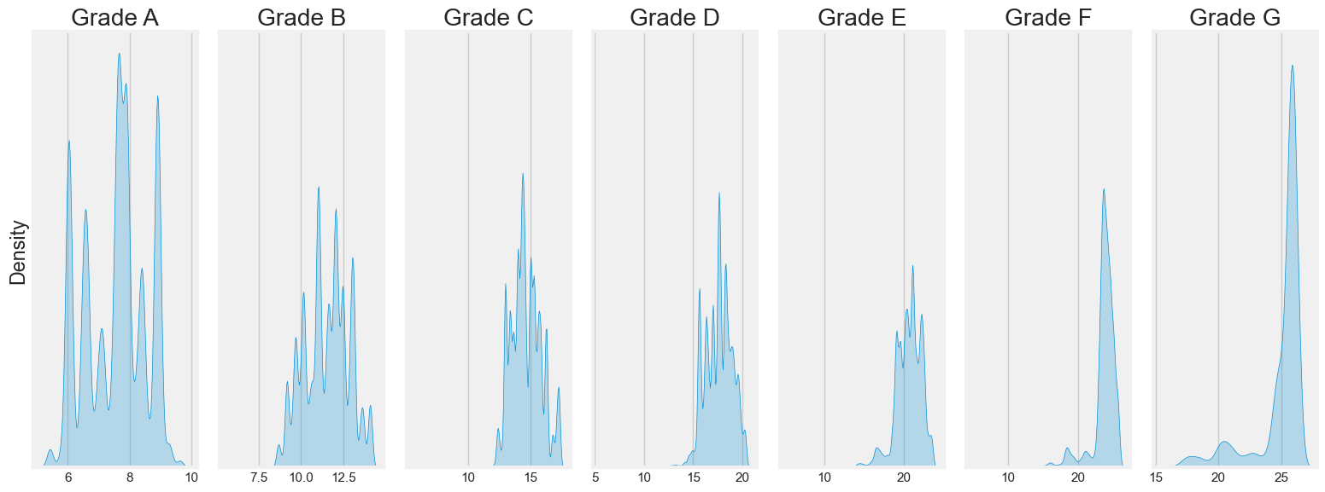
EDA & INSIGHT | UNIVARIATE ANALYSIS
Interest Rate by
Loan Grades
The lower the grade of a loan, the higher the interest rate. This is evidenced by how the most common interest rates for high-risk grades D, E, F, and G range from 15% to 27%, while lower-risk loans stay below 17%.

Slide 9
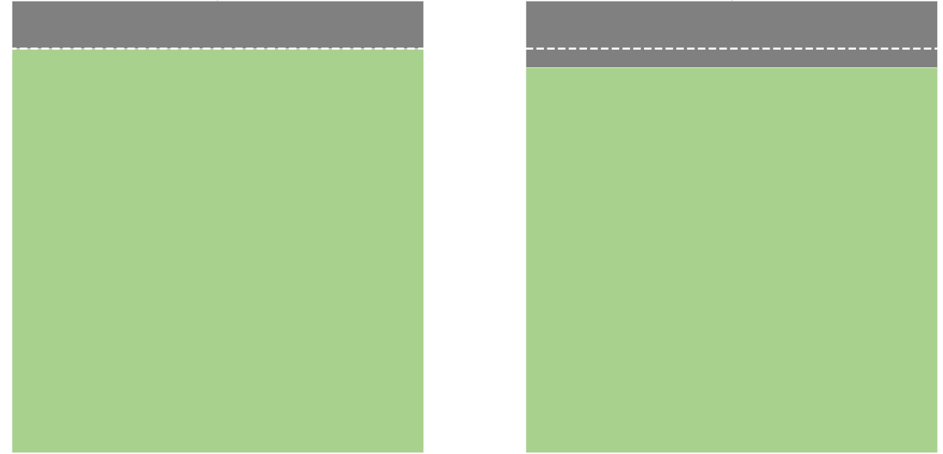
EDA & INSIGHT | UNIVARIATE ANALYSIS
>70%
The majority of the borrower opt for 36 months loan term.
±4%
Loans with a 36-month term have only a slightly better good loan rate despite their larger size.
64.89%
89.53%
85.35%
23.49%
7.59%
4.03%
36 Months
60 Months
36 Months
60 Months
Borrowers are risk-averse and prefer to minimize their exposure to potential financial difficulties over longer periods.
The minimal difference of good loans rate suggest that although borrowers strongly prefer shorter-term loans, there's potential to expand the 60-month loan offerings without significantly increasing risk.
The high good loan rate on both loan term suggest an effective risk models, but still providing the opportunity to further refine underwriting criteria for 60-months loan.

Slide 10
EDA & INSIGHT | UNIVARIATE ANALYSIS
30.19%
Employment Length Summary
The majority of borrowers with a high good loan rate also have a very long employment history.
10+ Years
30.19%
9 Years
3.54%
8.19%
8.04%
7.25%
7.07%
5.83%
6.07%
Tenure | Total
Short | 38,002
Medium | 174,205
Long | 96,940
Very Long | 157,138
5.14%
5.20%
5.55%
4.45%
3.51%
3.54%
1.04%
0.48%
9 Years
8 Years
6 Years
7 Years
4 Years
1 Year
5 Years
< 1 Years
3 Years
2 Years
10+ Years
A significant portion of borrowers have either a medium or very long employment history, which also correlates with their good loan rate. This is evidenced by the fact that the typical good loan rate in these categories is 1:10 relative to the bad loan rate, based on the size of each group. This suggests that a longer employment history is a positive indicator of creditworthiness.

Slide 11
EDA & INSIGHT | UNIVARIATE ANALYSIS
86.77%
+5 Years
11.38%
Significant portion of borrowers are those correlated with high creditworthiness and long credit history.
1.40%
2-5 Years
0.21%
0.22%
0-2 Years
0.03%
24.46%
Good Loan
Bad Loan
The number of good loans for borrowers with a long credit history is significantly higher than those of the other categories, averaging at 114,053 borrowers
The number of bad loans, regardless of credit history, is consistently seven times lower than the good loan rate.

Slide 12



EDA & INSIGHT | UNIVARIATE ANALYSIS
44.01%
32.04%
Middle income is significantly underrepresented, this could indicate a potential untapped market or a gap in the company's product offerings for this income segment.
12.33%
4.67%
5.24%
1.71%
Upper Income
Lower Income
Middle Income
Most of the borrowers with good loans are from the upper-income bracket. The comparably very low percentage of bad loans in this income bracket indicates that upper-income borrowers are more likely to have good loan performance and represent a less risky borrower segment.

Slide 13
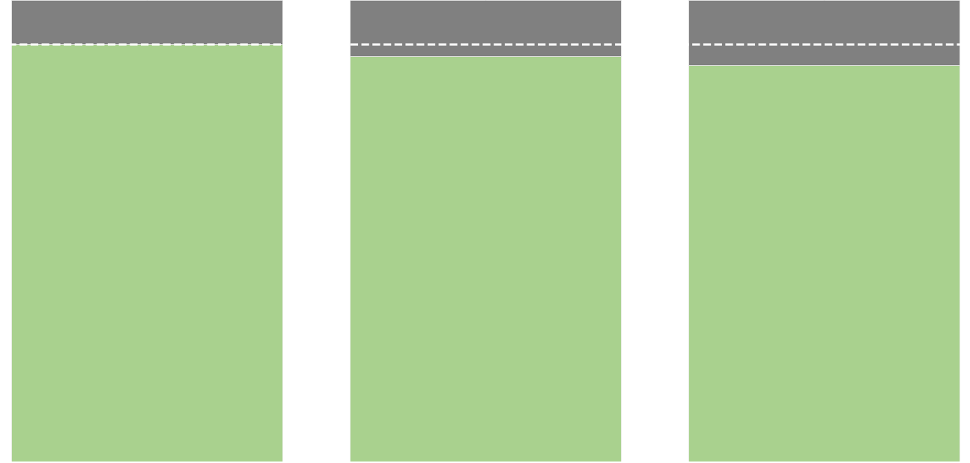
EDA & INSIGHT | UNIVARIATE ANALYSIS
9.59%
12.2%
14.04%
90.41%
87.8%
85.96%
Upper Income
Middle Income
Lower Income
There is an increase in the bad loan rate by 2-3% as borrowers' annual income decreases from the upper-income bracket to the lower-income bracket. This indicates that the lower a borrower's annual income, the riskier they become and the more likely they are to result in bad loans.
The minimal difference between the good loan rate of the upper-income bracket and other income brackets suggests that focusing lending efforts exclusively on this group may yield diminishing returns in terms of improving overall loan performance.

Slide 14
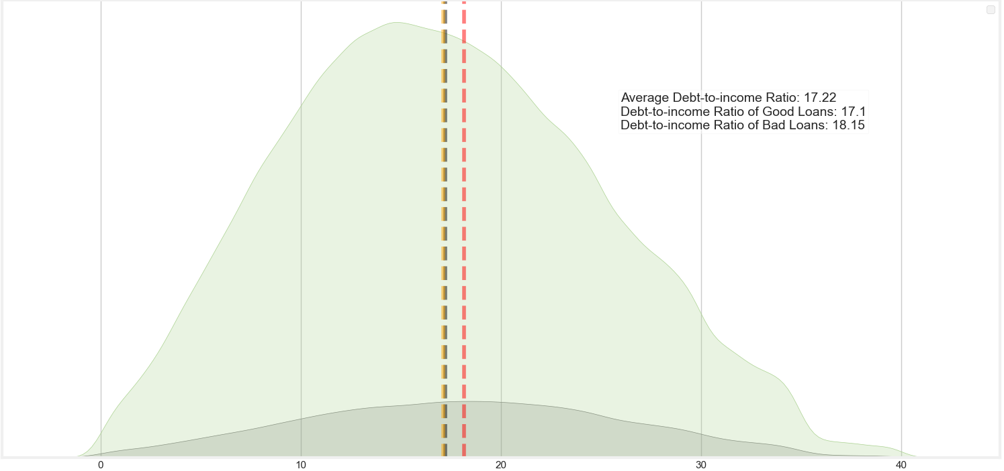
EDA & INSIGHT | UNIVARIATE ANALYSIS
Loan Status by
Debt-to-Income Ratio
There is a gradual increase in risk as DTI increases, which indicates that the higher the DTI becomes, the more likely borrowers are to struggle with loan repayments due to higher debt burdens relative to their income. This suggests that borrowers with very low DTI ratios below 10, or even below the overall average of 17.22, are less risky and more likely to maintain good loan status.
The overall average DTI (17.22) being closer to the good loan average suggests that the loan portfolio is generally healthy, with more good loans than bad loans.
0
10
20
30
40
The upper end of the dense range for good loans (20) could be considered a potential soft threshold for loan approvals or for implementing additional risk mitigation strategies, as this range is still fairly populated by borrowers with good loans.

Slide 15

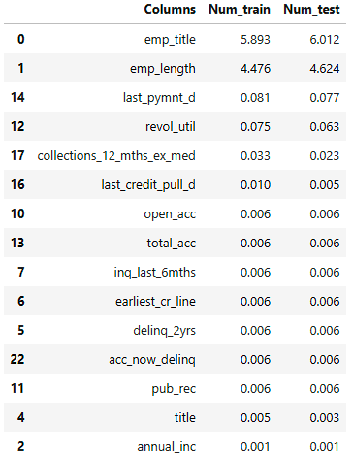
DATA PRE-PROCESSING| DATA ENGINEERING
Splitting Dataset
Feature Selection
Categorical Features Selection
Criteria used:
p-value < 0.05
Low Cardinality
The column ‘loan_status’ is used as the target variable (y), while the remaining columns serve as predictors (X). The test size is set to 20%.
Chi-squared is used to determine the p-value for each categorical features. Features with a p-value below 0.05 are considered to have a significant impact on the target variable, leading to the exclusion of 1 features.
Seven more features are excluded for the reason of high cardinality, and one feature is excluded because it has only 1 unique value.
Handling Missing Value
There are a total of 15 features with missing values:
Numerical Features Selection
Criteria used:
p-value < 0.05
correlation coefficient <= 0.7
The ANOVA F-statistic is used to determine the p-value for each feature. Features with a p-value below 0.05 are considered to have a significant impact on the target variable, leading to the exclusion of 3 features.
To further reduce multicollinearity, features with a correlation value above 0.7 are also excluded, resulting in the removal of 1 additional feature.
Missing values in categorical features are replaced with their most frequent values, while those in numerical features are replaced either with (0) or their average value, depending on the context.

Slide 16


DATA PRE-PROCESSING| DATA ENGINEERING
Feature Encoding
One-hot encoding was applied to the categorical features, increasing the number of features from 36 to 62. The remaining two categorical features with an ordinal nature were encoded using label encoding.
SMOTE
Handling Outliers
To address the imbalanced dataset, the SMOTE oversampling technique was applied. This process generated synthetic data points for the underrepresented class, resulting in a balanced dataset with equal proportions of both classes.
The Interquartile Range (IQR) method was used to assess whether there are values in a feature that exceeded its lower and upper bound. Twenty one (21) features were identified as having outliers beyond this limit. Log transformation was then applied to reduce these outliers. For features with remaining outliers, winsorization was applied at the 25th and 75th percentiles, effectively eliminating all remaining outliers.

Slide 17
MODELLING| BASE MODEL
Model: Five Classification Algorithms
Data: Test data
Model | AUC | Precision | Recall
Logistic Regression | 0.96 | 0.97 | 1
Decision Tree | 0.94 | 0.99 | 0.98
Linear SVC | 0.96 | 0.98 | 0.99
Random Forest | 0.99 | 0.98 | 1
CatBoost | 0.99 | 0.98 | 1
Recall will primarily be used to evaluate the model, as it measures the model's ability to correctly identify all positive instances (1) or borrowers who actually have good loans.
Precision will also be used, as it measures the model's ability to avoid incorrectly predicting bad loans (0) as good loans (1). This is because failing to identify those who may result in bad loans could be more costly than the potential loss of revenue from missing good borrower.
AUC (Area Under the Curve) will also be used to measure how well the model can differentiate between borrowers who have good loans (1) and those who don’t (0).

Slide 18
MODELLING| BASE MODEL
Model | AUC (Vanilla) | AUC (SMOTE) | Precision (Vanilla) | Precision (SMOTE) | Recall (Vanilla) | Recall (SMOTE)
Logistic Regression | 0.96 | 0.96 | 0.97 | 0.98 | 1 | 0.97
Decision Tree | 0.94 | 0.92 | 0.99 | 0.98 | 0.98 | 0.97
Linear SVC | 0.96 | 0.97 | 0.98 | 0.99 | 0.99 | 0.83
Random Forest | 0.99 | 0.99 | 0.98 | 0.98 | 1 | 0.99
CatBoost | 0.99 | 0.99 | 0.98 | 0.99 | 1 | 0.99
Imbalanced vs Imbalance Data
The model's performance has slightly improved across each of the metrics used, suggesting it is better fitted and more effective at identifying the positive class while differentiating between classes in a balanced distribution.
Based on the models performance evaluations, Logistic Regression, Decision Tree, and CatBoost are chosen to be hyper-tuned later.

Slide 19
MODELLING| HYPERTUNING
Model | Parameter Runtime (s) | Model Runtime (s) | Precision | Recall
Logistic Regression | 718.03 | 61.11 | 0.98 | 0.96
Random Forest | 332.17 | 107.63 | 0.97 | 0.99
CatBoost | 471.64 | 44.88 | 0.98 | 0.99
Model Hyper-tuning
GridSearchCV and RandomizedSearch is used to find the optimal combination of parameters for the models by evaluating them across a provided grid of parameters.
CatBoost was selected as the best model after hyperparameter tuning due to its superior precision and recall score, minimal gap with better performance, and faster model fitting compared to other models.

Slide 20
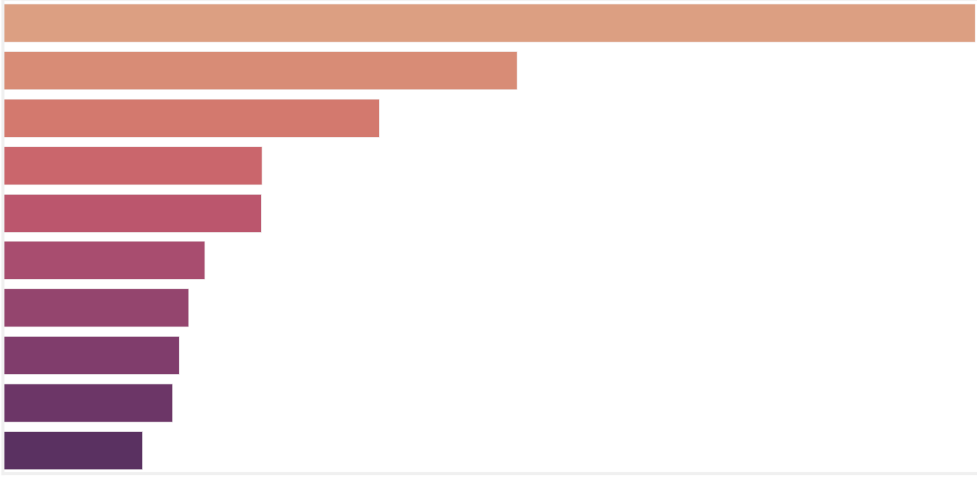
MODELLING| FEATURE IMPORTANCE
Feature Importance
Inq_last_6mths
22.2
Collection_recovery_free
Total_rec_prncp
Out_prncp_inv
Out_prncp
Purpose_debt_consolidation
installment
Open_acc
Funded_amnt
Emp_length_10+_years
10 features are found with the highest importance value, which suggest that these columns are likely to be the highest determining factor in predicting borrowers with good loans status. Features in the top 10 for feature importance, as well as those outside of it, will be re-categorized into categories matching the factors used in the FICO credit scoring method, which consist of payment history, amounts owed, length of credit history, credit mix, and new credit.

Slide 21
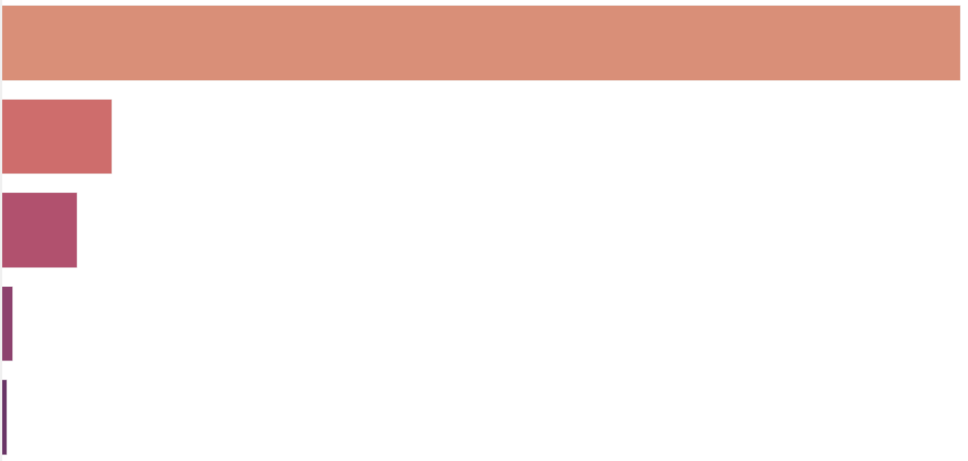
MODELLING| MODEL RESULTS
Borrowers by Credit Score
Excellent
(800-850)
82.41%
Poor
(300-579)
9.52%
Very good
(740-799)
6.55%
Good
(670-739)
1.00%
Fair
(580-669)
0.53%
The results shows that a significant portion of the borrower base, approximately 82%, have excellent credit scores in the range of 800 to 850. This aligns with the previous analysis of borrowers' loan status distribution, which shows that nearly 90% of all borrowers have good loans and mostly have either low interest rates or long credit histories, indicating that these borrowers are at the higher end of creditworthiness.
This also suggests that the company has employed an effective risk assessment methodology, as evidenced by the fact that, despite nearly 10% of borrowers having poor credit scores, the original distribution still shows a large portion of borrowers with good loans. Borrower whose credit score in fair, good, and very good make up the minority of the borrower base with the combine percentage of around 8%. this suggest that there might be untapped potential in expanding services to borrowers in the fair to very good credit range, which could diversify the portfolio further.

Slide 22
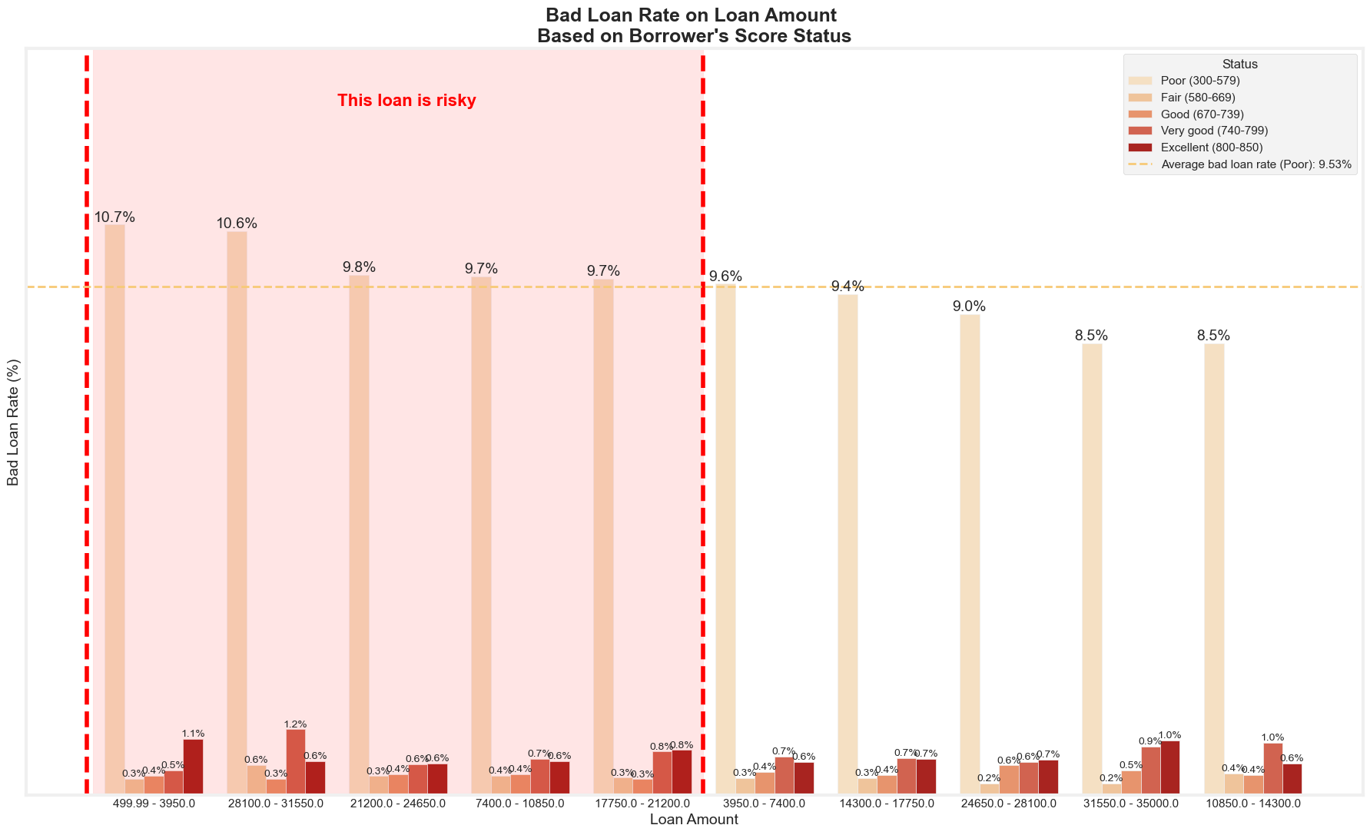
EDA & INSIGHT | MODEL RESULTS
Bad Loan Rate on Loan Amount
Based on Borrower’s Scores Status
Borrowers whose loan amounts are at either the lowest or at the middle ends tend to consist of a high percentage of borrowers with poor credit scores, averaging around 10%. In addition, the small percentage of borrowers with good or better credit scores makes loans at these amounts risky and potentially more likely to result in a higher number of bad loan cases.
Loan amounts ranging from 10,850 to 17,750 and from 31,550 to 35,000 have lower percentages of borrowers with poor credit scores, while also having a relatively fair number of borrowers with good or better credit scores compared to other loan amount ranges. This suggests that loans within these amounts may potentially be safer options for loan approval.
Borrowers with low or mid-range loan amounts tend to have higher risk due to poor credit scores. In contrast, certain loan ranges have fewer poor credit borrowers and more good credit borrowers, making them safer for approval.

Slide 23
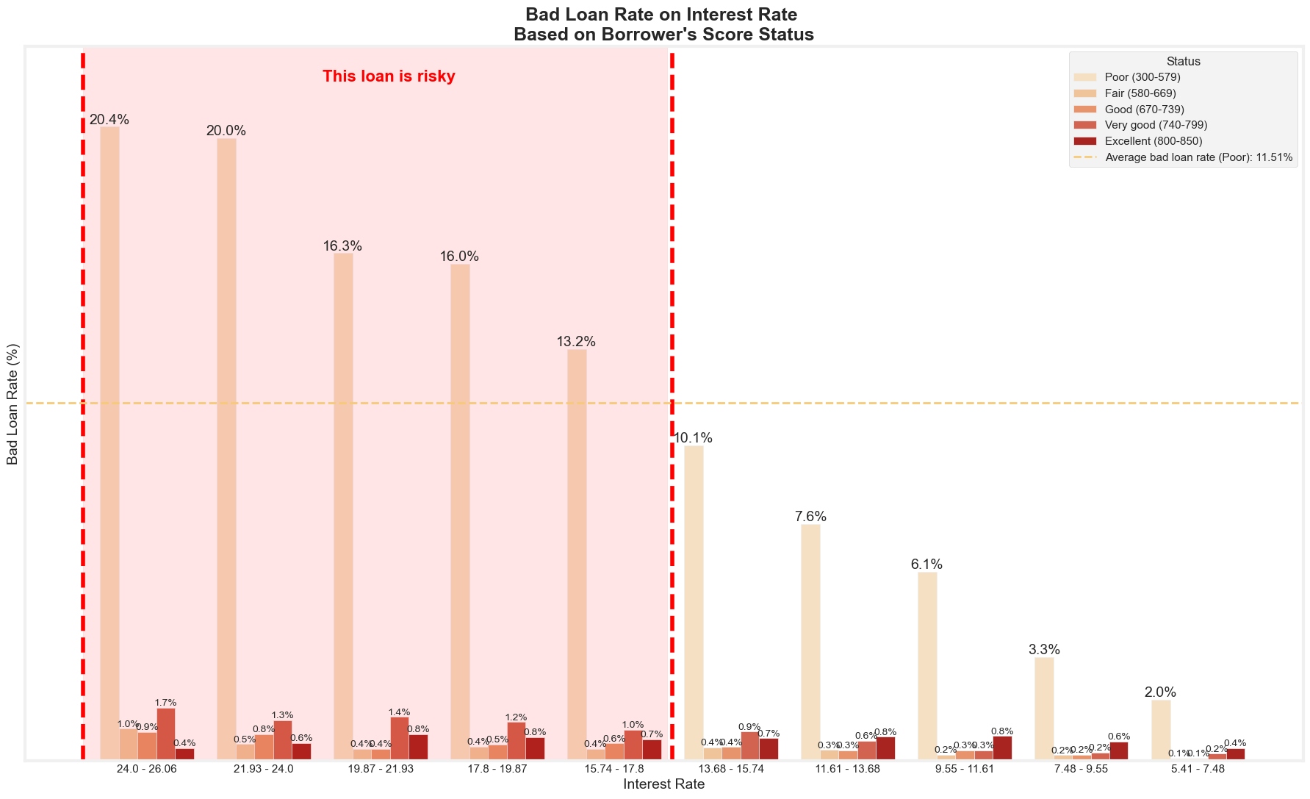
EDA & INSIGHT | MODEL RESULTS
Bad Loan Rate on Loan Amount
Based on Borrower’s Scores Status
Interest rates from 15.74% to 26.06% are the riskiest, with up to 20.4% of borrowers having poor credit scores, increasing the likelihood of bad loans. These borrowers should be closely monitored or reconsidered for approval, as higher rates correlate with higher risk.
There is a consistent trend showing that borrowers with at least a fair credit score, up to those with excellent credit scores, are less likely to result in bad loans. This suggests that encouraging borrowers to improve their creditworthiness to at least a fair credit score will significantly decrease the likelihood of loans experiencing difficulties that could potentially lead to default. It also suggests that prioritizing loan approval for those with at least fair credit scores may be more beneficial, as they present less risk, and might reduce potential losses.
Higher interest rates pose the greatest risk due to more borrowers with poor credit. Prioritizing borrowers with fair or better credit can reduce defaults and improve loan outcomes.

Slide 24
CONCLUSION| BUSINESS RECOMMENDATION
Based on the results gained from previous analysis and credit scoring done by the machine learning models, it is imperative for the company to adjust aspects regarding borrowers loans approval and the borrowers credit health in general. Thus recommendations that would improve this conditions are created.
What the company need to do based on Loans Approval are:
Tighten Approval Criteria for Poor Credit Scores, Based on the information gathered about the borrower as a loan applicant, the company can implement stricter approval criteria if the applicant is found to have a poor credit score or low creditworthiness. Depending on the decision, the company may also consider requiring additional collateral or co-signers for these high-risk applicants.
Early Warning System, The company could develop a system to identify early signs of potential default among borrowers with poor credit scores, based on either the borrowers' credit scores or factors affecting them, such as their credit behavior (utilization, frequent loan applications) or their overall financial health (cash flow, debt-to-income ratio). Based on this, the company could then implement a proactive interventions for at-risk borrowers, such as payment plans or loan restructuring.
Portfolio Rebalancing, By adjusting the approval criteria, the company should gradually shift the loan portfolio toward a higher proportion of borrowers with fair or better credit scores, focusing efforts on reducing the percentage of poor credit score borrowers over time.
What the company need to do based on Borrowers Credit Health are:
Credit Improvement Program, The company could offer a program to help borrowers improve their credit scores, which could include financial education in the form of resources on credit management. Additionally, the company could provide a credit monitoring and improvement tool for customers (web or mobile application), helping them monitor and stay updated on changes to their credit.
Incentives, Based on the results of the improvement program and the borrowers' progress over time after participating in the program, the company could offer incentives, such as interest rate reductions, to borrowers who actually improve their credit scores

